Slide 1
Wampum
East Coast Story Telling

Slide 2
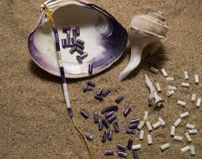
Traditional wampum was Laboriously hand carved beads from Quahog and Welk Shells, wampum was used as visual story telling by East Coast Aboriginal peoples.

Slide 3
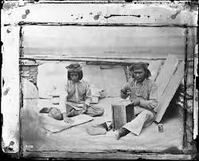

Slide 4
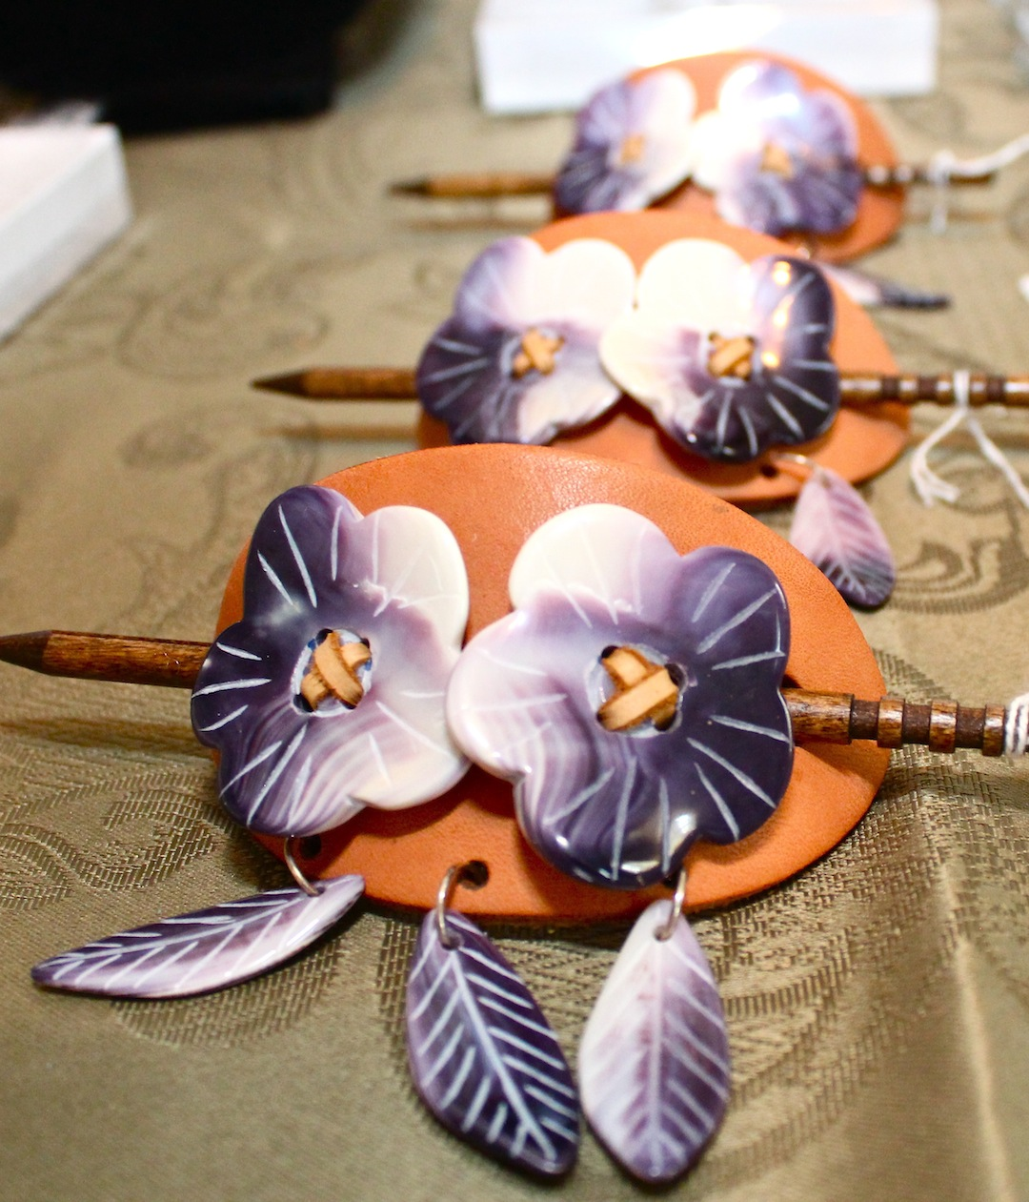
Wampum is considered sacred to nations that make up the Wabanaki Peoples.

Slide 5
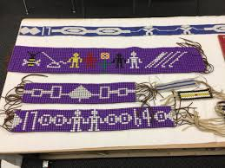
Wampum has been used as a currency, for gifts, recording events, demonstrating a position of power…..

Slide 6
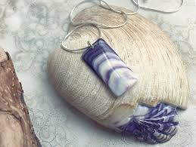
Wampum was so highly regarded and prized it was used as an exchange for value until the 1700’s.

Slide 7
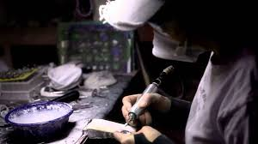
Due to the impact of Colonization, the spread of the Industrial Revolutions machines, and faster processing, wampum stopped being used as bank currency between nations during the 1700’s

Slide 8
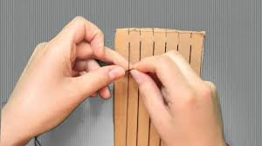
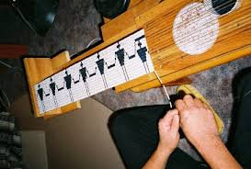
Wampum being made into traditional belts
Starting the process
Weaving the beads onto the sinew

Slide 9
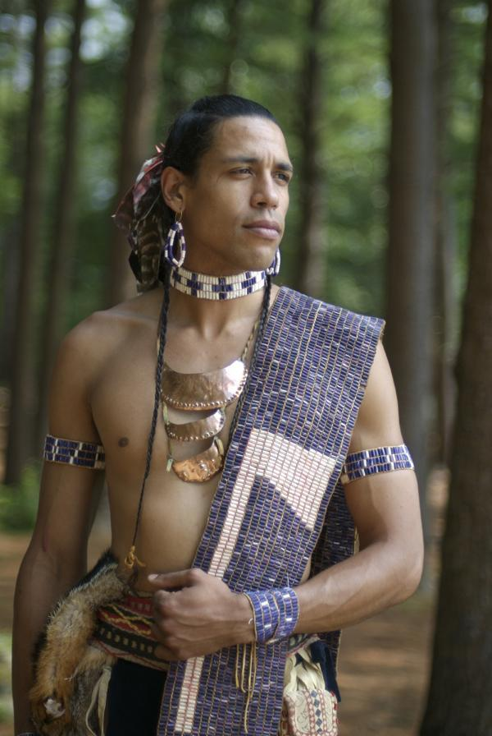
This is an actor wearing regalia including wampum for a movie.

Slide 10
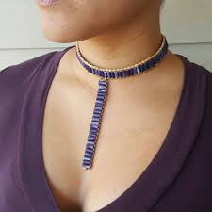
Wampum cut and shaped into beads, and used for jewellery

Slide 11
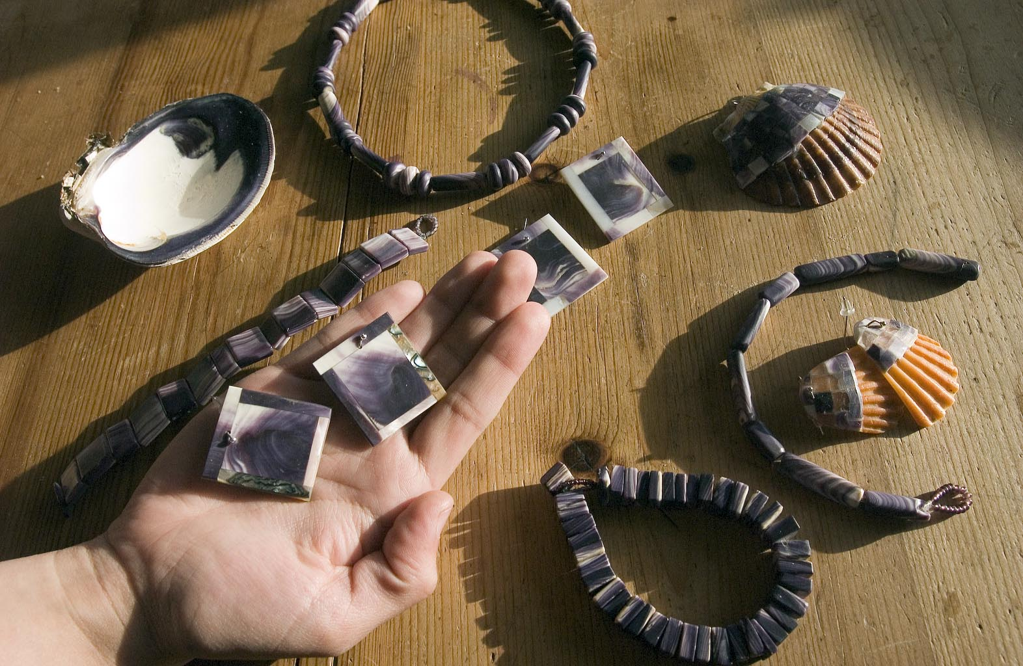
Wampum is often used for everything from simple jewellery, ceremonial belts, and art.

Slide 12

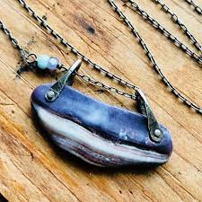
Nontraditional jewellery with wampum

Slide 13
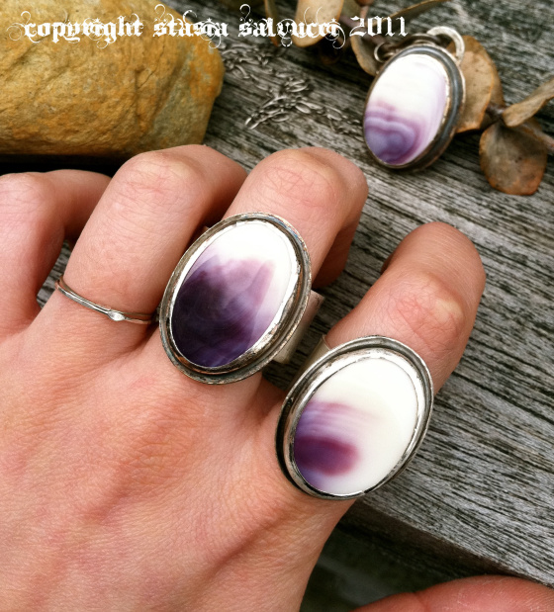
Wampum used as gemstones in jewellery

Slide 14
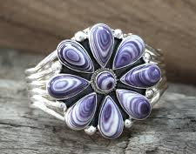
Wampum again used as gemstones in silver jewellery.

Slide 15
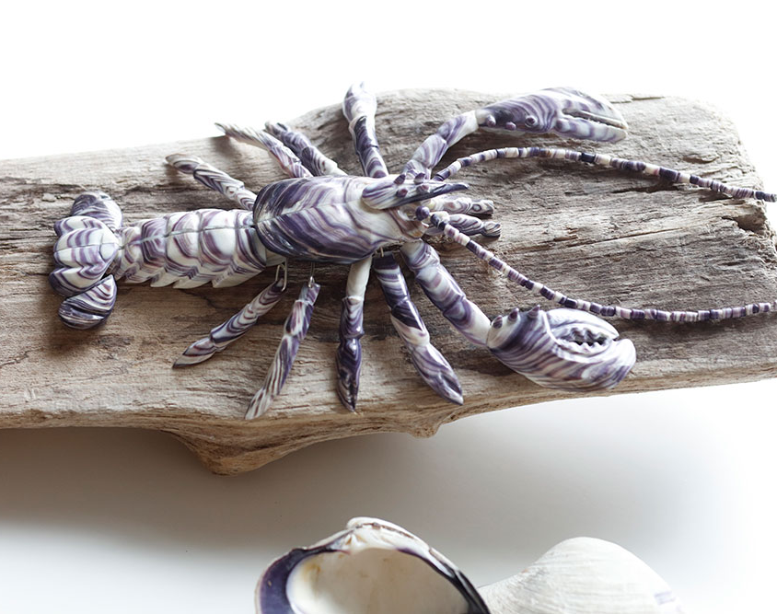
Wampum sculpture carved by Marcia Poirier from Wild About Wampum, here in NB Canada. Quahog shell is symmetrical on both sides.
Notes:
5000 commission piece
Already commissioned to do 2 others

Slide 16
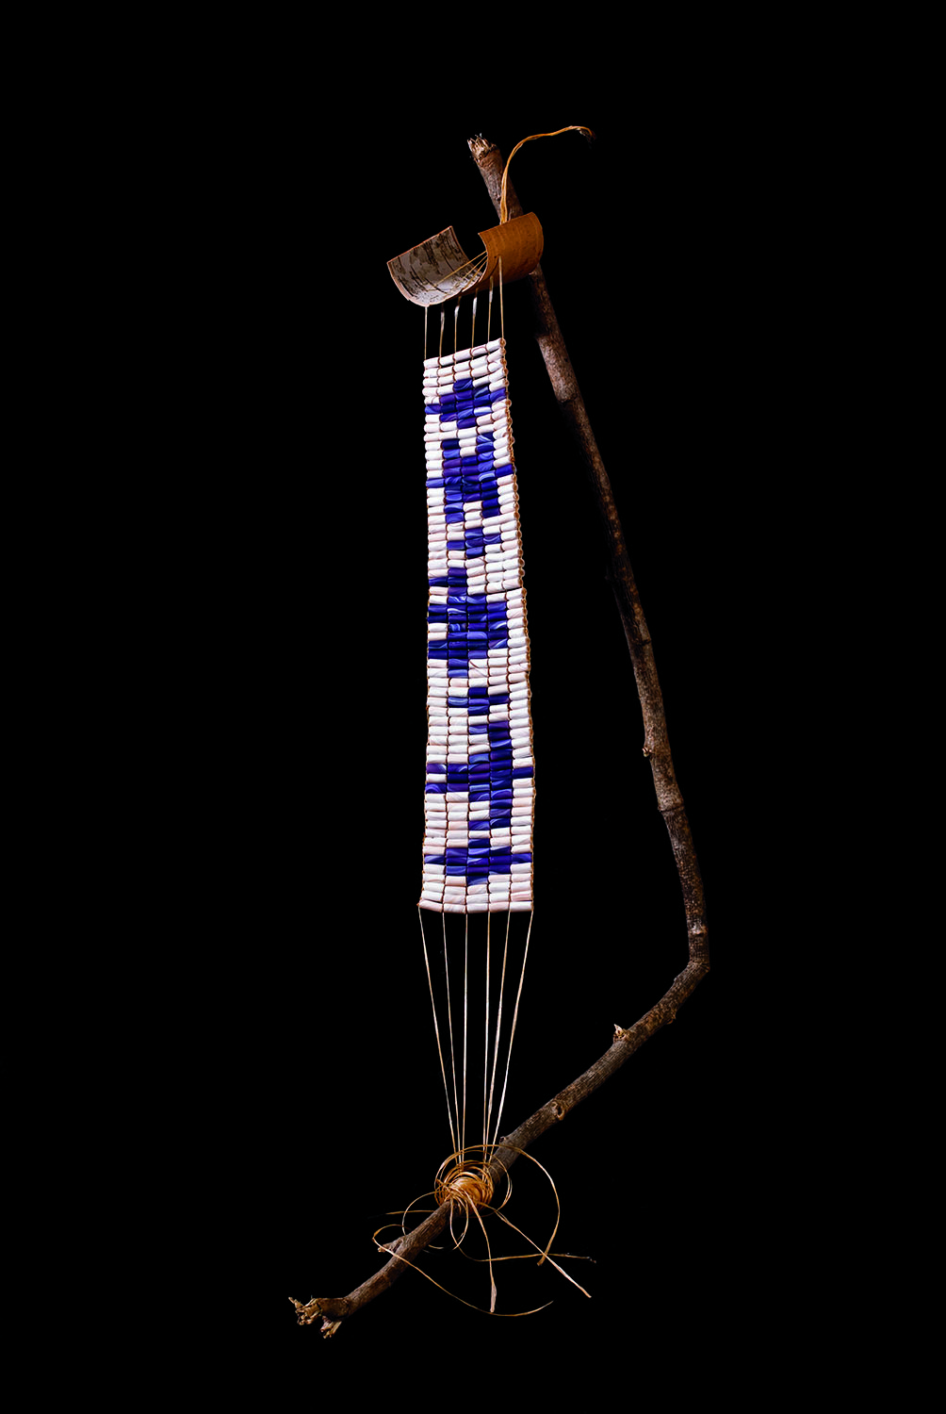
Wampum Belt
Wampum has not been extensively recorded in imagery due to the sacredness, and intention of the work. NBCCD is very excited to support the ongoing efforts of AVA in encouraging students to explore this medium. Students don’t need an expensive frame.
Notes:
Art doesn’t have to cost money
A frame can be a branch
Start where you are
Tape and a table

Slide 17
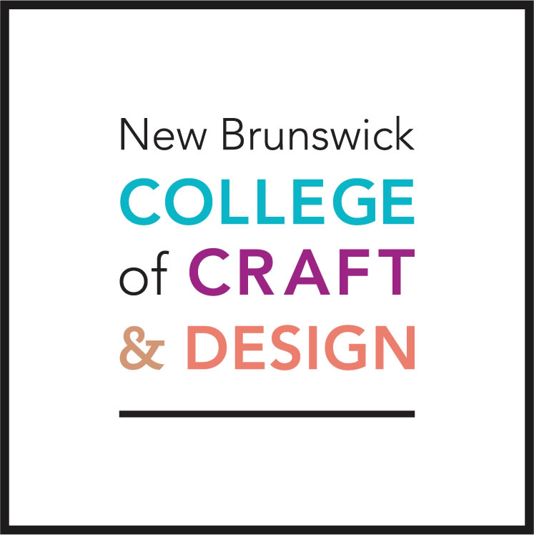
Dan Robichaud
Dan.Robichaud@gnb.ca
453-3343
Judie Acquin-Mikovsky
Judie.Acquin-Miksovsky@gnb.ca
453-2645

